Slide 1

Solving the travelling surveyor problem
With .NET and Google OR Tools

Slide 2

Introduction:
Technical Lead at Landmark Information Group, I've a very broad experience of software development over 15 years and a passion for both technology and elegance in my solutions that make me an extremely capable software architect.
Personable and professional, I revel in complex challenges, but always make time to coach and mentor team members.
@rammesses joel@hammond-turner.org.uk

Slide 3

Introduction:
Landmark is at the forefront of legal products and data supply to the UK’s property market. Our pioneering technology, data, reports and expert team enable thousands of successful property transactions, every day. Landmark is a true PropTech, LegalTech and EnviroTech innovator.

Slide 4

Introduction:
Valuation Hub
End to end residential property transaction lifecycle management, seamlessly coordinating Lender and Surveyor case management through configurable workflow.
Valuation Hub is your window into the Secure Panel Network, providing Lenders access to the community of UK Surveyors, and enabling Surveyors to complete cases securely, accurately and on time, every time

Slide 5
Spoiler! it’s all in Azure

Slide 6
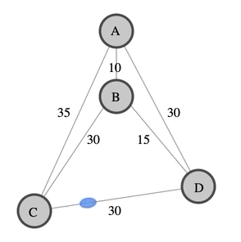
The Classical Travelling Salesperson Problem
1800s
W.R. Hamilton formulates TSP mathematically
1930s
Karl Menger, observes the non-optimality of the nearest neighbour solution
1949
Julia Robinson coins phrase "Travelling Salesman Problem"
2006
Cook et al solve optimal
85,900 “city” microchip layout problem
https://en.wikipedia.org/wiki/Travelling_salesman_problem

Slide 7

The Classical Travelling Salesperson Problem
Exact Algorithms:
Brute Force – O(n!)
Held-Karp – O(n²2^{n})
Branch-and-bound - < 75 “cities”
Progressive Improvement - < 200 “cities”
Branch-and-Cut (Applegate) – ~85,900 “cities”
Heuristic (Approximate) Algorithms
Nearest Neighbour
Christofides & Serdyukov
Pairwise Exchange
Kin-Kernighan Heuristics
V-opt Heuristic
Randomised Improvement
Ant-Colony Optimisation
So many ways to skin the cat…

Slide 8

The requirement is simple, right?
R-BK-032: Booking a Survey
As a Survey Booker
I want to be shown a scored set of surveyors and timeslots
So that I can optimally make a survey booking

Slide 9

The Complexity of requirements
Many surveyors cover surveys in any given area
But surveyors don’t all have the same work patterns
And surveyors have points targets
And some surveyors can’t do certain jobs
The survey could happen on any of many days
But we want it done as soon as possible
We want to minimise the distance a Surveyor drives
But we also want to share the work fairly
How Haley books a survey
Haley calls Tom at Friends Estate Agents on The High Street to check their opening times to pick up the keys for Flat 1, 26 Lower Back Street.
She then picks the suggested afternoon slot and saves the provisional appointment for the mortgage valuation survey that will be given to one of the Staff Surveyors.
R-BK-032: Booking a Survey
As a Survey Booker
I want to be shown a scored set of surveyors and timeslots
So that I can optimally make a survey booking

Slide 10
The Complexity of Requirements
It’s not just one appointment
Keys need to be collected and dropped off
But Estate Agents have opening hours
The occupier wants to know exactly when to expect the surveyor
But we want flexibility to reorganize
We have 100s of Surveyors, 1000s of jobs per day
And want to plan up to a month in advance
How Haley books a survey
Haley calls Tom at Friends Estate Agents on The High Street to check their opening times to pick up the keys for Flat 1, 26 Lower Back Street.
She then picks the suggested afternoon slot and saves the provisional appointment for the mortgage valuation survey that will be given to one of the Staff Surveyors.

Slide 11
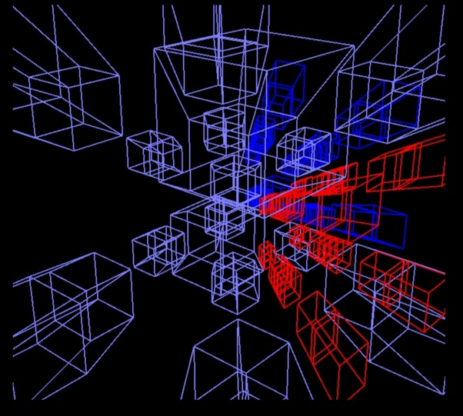
An N-dimensional routing problem

Slide 12
An N-dimensional routing problem
Surveyors & Shifts
Start and End points
Points & Restrictions
Windows & ETAs
Distances & Times
Key pickups and drop-offs
Problem Constraints

Slide 13


Introducing Google OR-Tools
https://developers.google.com/optimization

Slide 14
Introducing Google OR-Tools
What is it?
Open Source optimisation library
Fast native libraries for Linux / MacOS / Windows
Multiple language bindings
Python, JAVA, C++ & .NET
Multiple solvers
Supports 3rd party / commercial solvers
Broad range of capabilities & solvers
Linear Optimisation – GLOP Solver
Integer Optimisation – SCIP Solver
Constraint Optimisation – CP-SAT Solver
Assignment – Linear Assignment Solver
Routing – Constraint Route Solver
Bin Packing – Knapsack Solver
Network Flows – MinFlow / MaxFlow Solvers
Scheduling -

Slide 15


Getting started with Google OR-Tools
File ➔ New Project ➔ .NET Core 3 Console App
Install-Package Google.OrTools
Define your problem
Configure a Solver
Run the problem through the solver
Print the results
Google.ORTools.Runtime.xxx
https://www.nuget.org/packages/Google.OrTools/

Slide 16

Demo – Solving the TSP with Google OR tools
SHOW ME THE CODES!

Slide 17
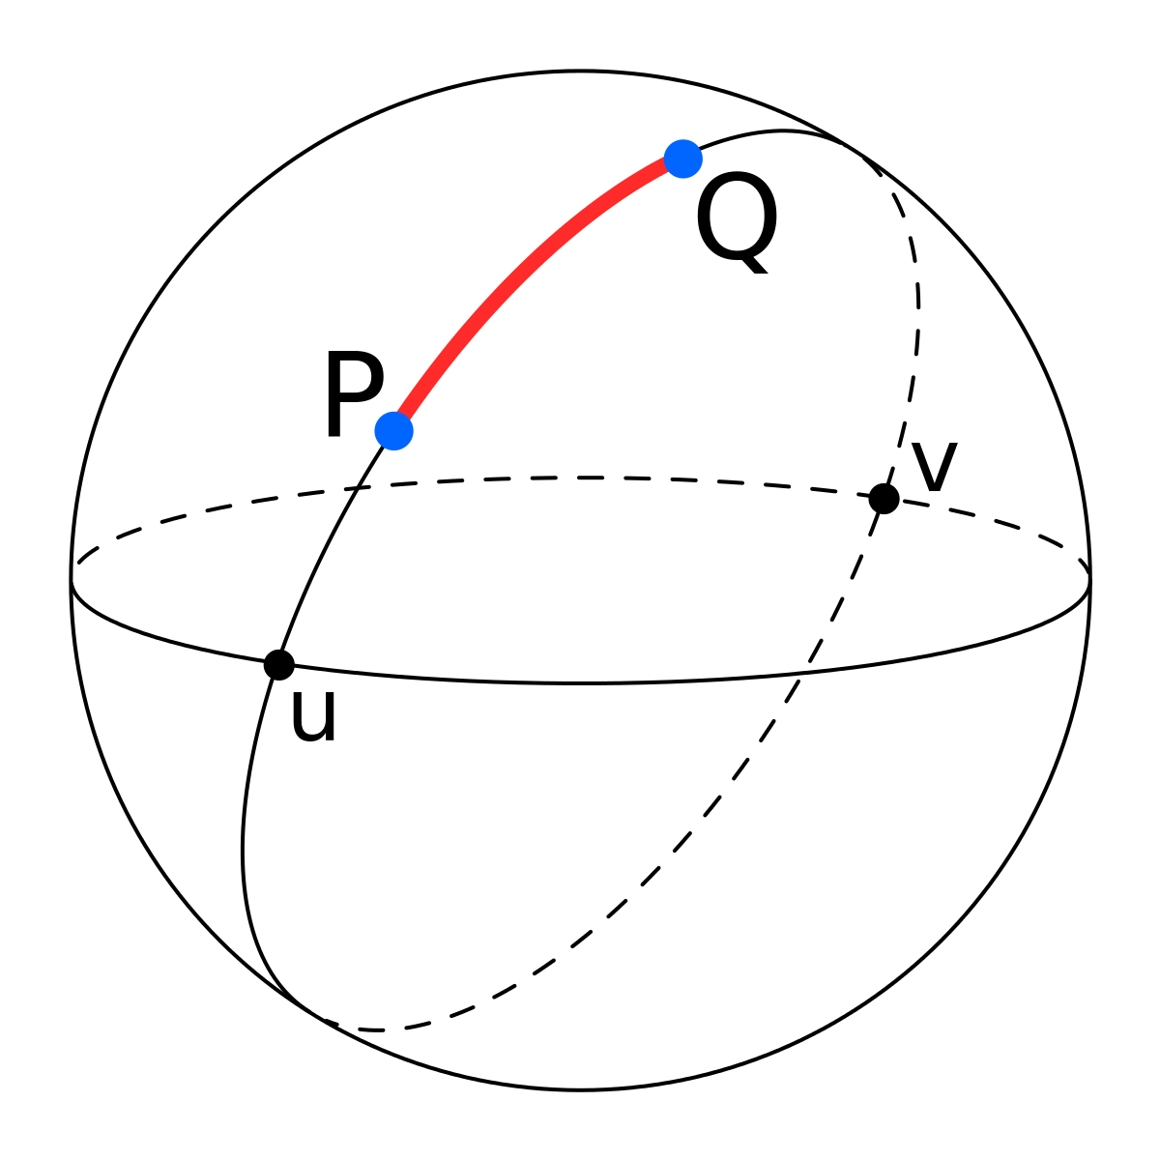
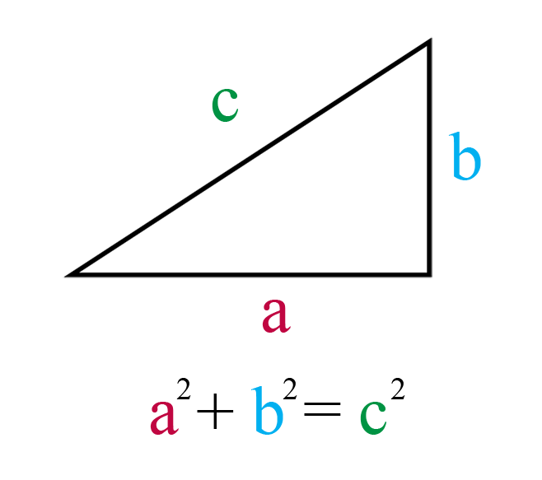
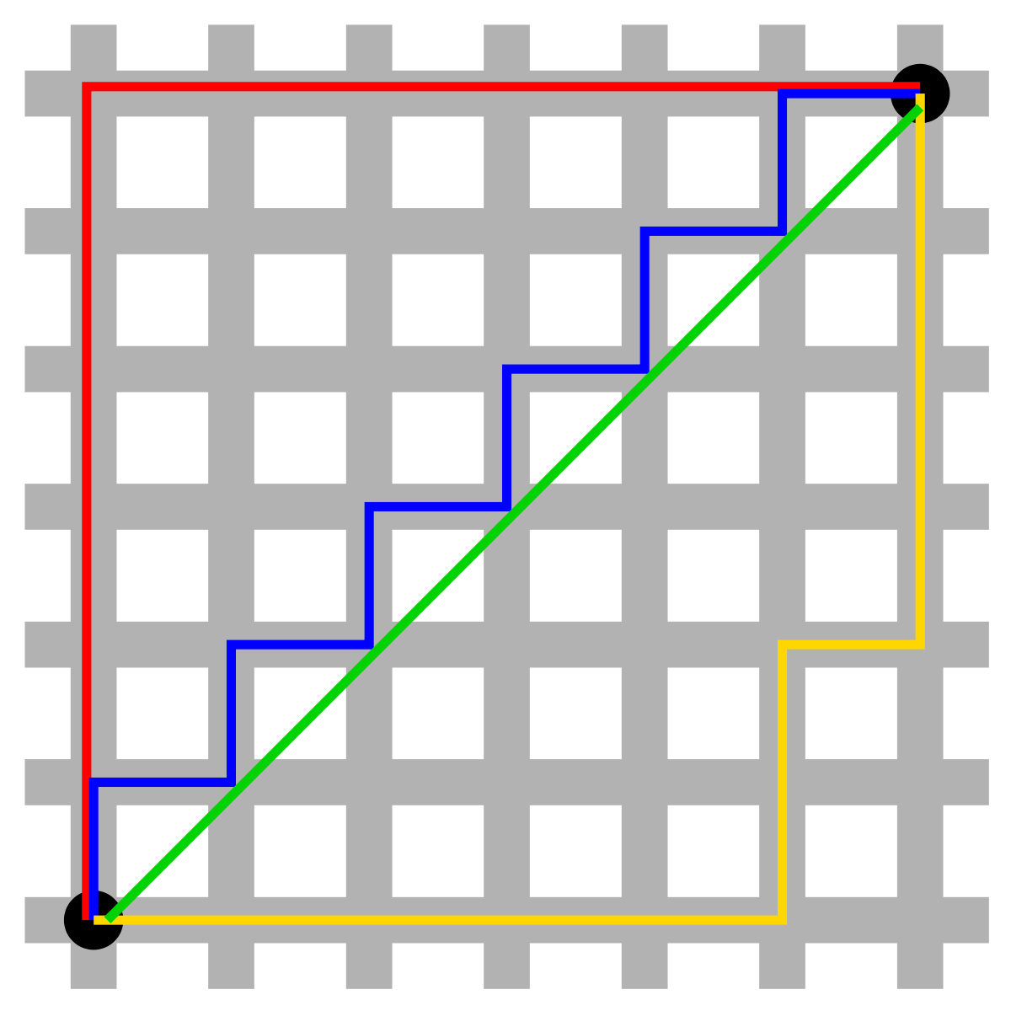
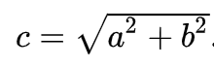
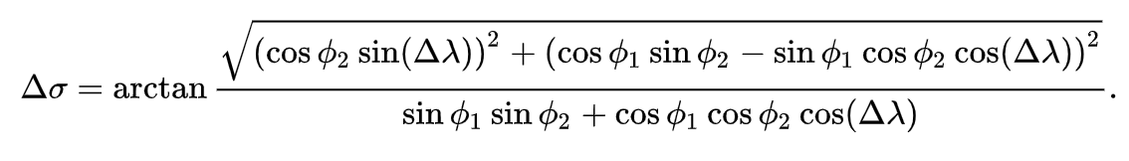
Aside: Calculating Distances
Straight-Line (Pythagorean) Distance
Rectilinear (Manhattan) Distance:
(x₁, y₁) to (x₂, y₂) ➔ |x₁ - x₂| + |y₁ - y₂|
Great Circle Distance ( Vincenty formula )

Slide 18
Aside: Calculating Distances
Google Distance API:
https://maps.googleapis.com/ maps/api/distancematrix/json ? units =imperial & origins=3610+Hacks+Cross+Rd+Memphis+TN & destinations=3734+Elvis+Presley+Blvd+Memphis+TN & key=YOUR_API_KEY
{ "destination_addresses" : [ "1921 Elvis Presley Blvd, Memphis, TN 38106, USA" ], "origin_addresses" : [ "3610 Hacks Cross Rd, Memphis, TN 38125, USA" ], "rows" : [ { "elements" : [ { "distance" : { "text" : "15.2 mi", "value" : 24392 }, "duration" : { "text" : "21 mins", "value" : 1264 }, "status" : "OK" } ] } ], "status" : "OK" }

Slide 19

Demo - Multi-vehicle routing

Slide 20
Recommending a surveyor
Calculate the TSP route for the current schedule (for each day within SLA)
Repeat for all candidate surveyors
Offer the ”best” surveyor / day
Calculate the TSP route for the schedule with the new case added (for each day within SLA)

Slide 21
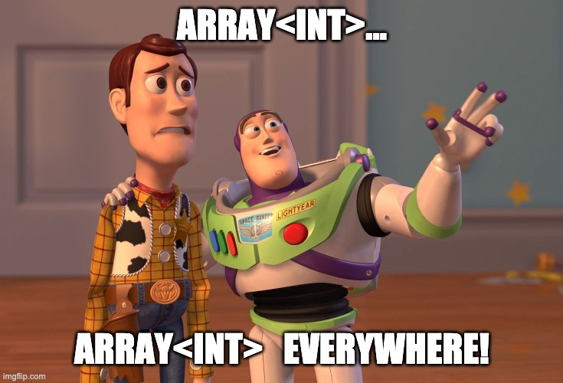
Aside: The need for a DSL
Google.OrTools for .Net is a thin wrapper over C++
Nodes… Array<int>
Vehicles… Array<int>
Solutions… Array<Array<int>>
Evaluators… Array<Func<int, int>>
Dimensions… Dictionary<string, int>
Writing tests for Google OR Tools is H-A-R-D !

Slide 22
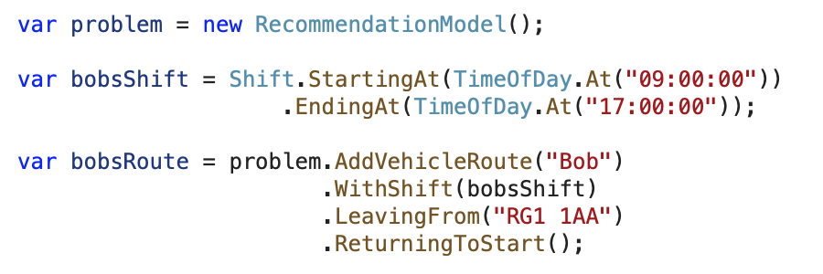
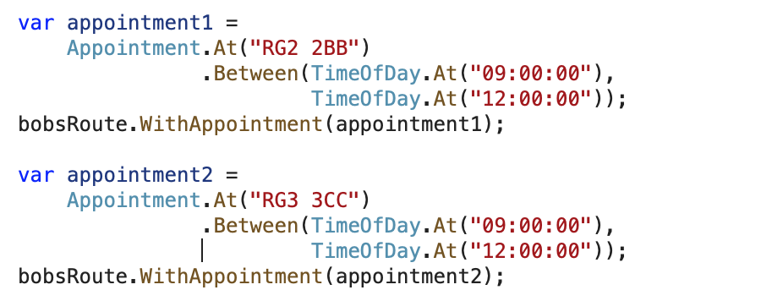
Aside: The need for a DSL
Define your problem & vehicles
Define some appointments

Slide 23
Demo - A working DSL for Google OR Tools

Slide 24
Into production – putting it all together
SQL Server
50 million rows of travel time data
Cosmos DB
Record every recommendation
Azure Functions
Hosting the OR-Tools engine
API Management
Security & access control

Slide 25
Into production – putting it all together
1,000 Cases per hour
50 bookers @ 1 per 4 minutes
2-4 Surveyors (of 250) per case
5-10 day SLA
Average 6 cases / day
10-40 Surveyor / day combinations
10 appointments / day
120+ nodes / solution
10,000 Function calls / day
Average 10s per call

Slide 26
Wrapping up – what we’ve seen
Scheduling jobs for surveyors (or other people) can be hard
The problem space is be n-dimensional
Understand the problem
Define ”optimal”
Google OR-Tools provides fast solvers
Assuming you remember to import the platform dlls!
Calculate your distance / time data up front!
Google Maps API costs $$$
The Google OR-Tools API is slim
A DSL makes defining problems reasonable
And makes unit tests possible
Users will want to understand the recommendations
Save them!

Slide 27
Wrapping up – what we’ve seen
Email: joel@Hammond-turner.org.uk
Twitter: @Rammesses
Web: https://www.hammond-turner.org.uk
Repo: https://bit.ly/or-tools-samples
https://developers.google.com/optimization

